Slide 1
Topic: Naming Triangles Eq: How can we use angles and sides to name triangles?
Rule up 3 column notes!
Year 9

Slide 2
24
7
30
Naming Triangles
Date
EQ – How can we use angles and sides to name triangles?
Question
Examples
Steps

Slide 3
5 questions
What is the formula for finding the hypotenuse?
What is the formula for finding the short side of a triangle?
Find the missing side of the following triangle:
What does all the angles in a triangle add up to?
6 cm
14 cm
y

Slide 4
What we will cover
- Use the enlargement transformation to explain similarity and develop the conditions for triangles to be similar
- Solve problems using ratio and scale factors in similar figures

Slide 5
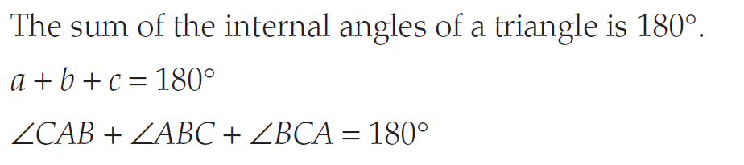
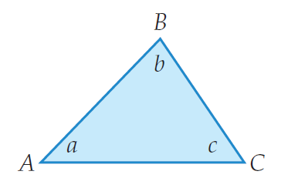
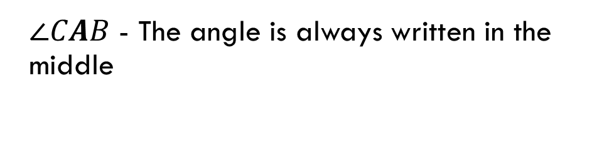
24
7
30
Naming Triangles
Date
EQ – How can we use angles and sides to name triangles?
Question
Examples
Steps
Angles in a Triangle
$∠CAB$ - The angle is always written in the middle

Slide 6
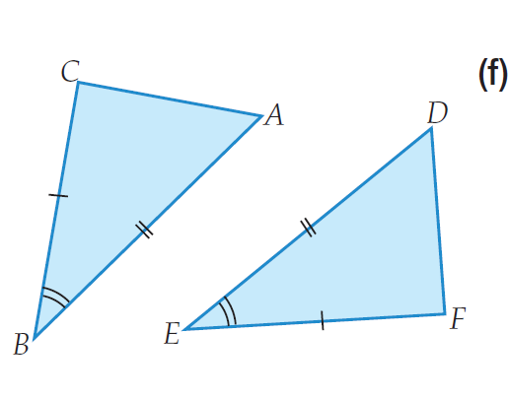
Name the following angles on the triangles

Slide 7
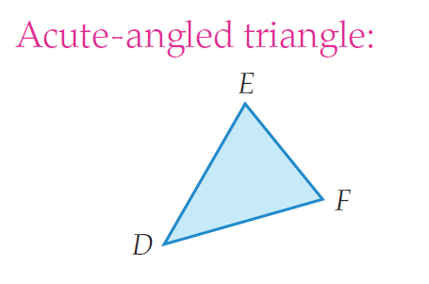
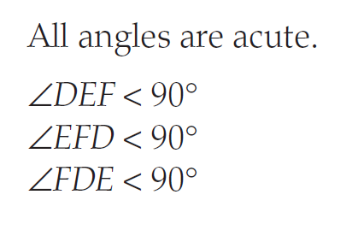
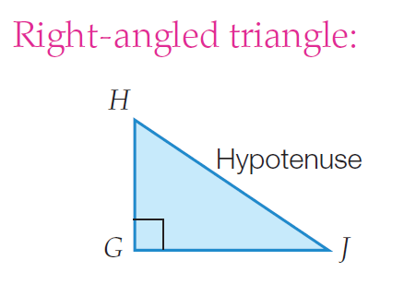
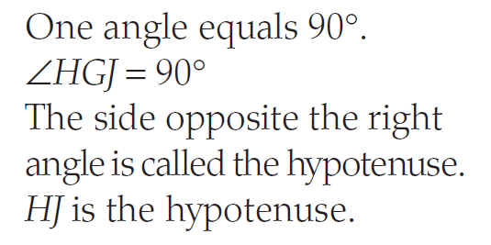
24
7
30
Naming Triangles
Date
EQ – How can we use angles and sides to name triangles?
Question
Examples
Steps
Naming Triangles due to their Angles

Slide 8
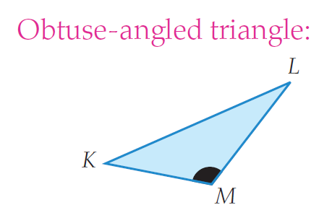
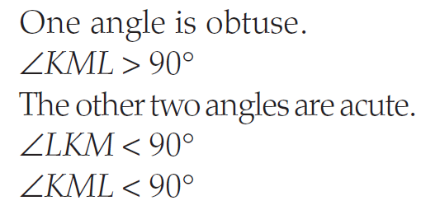
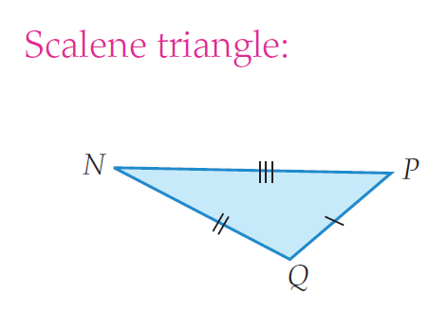
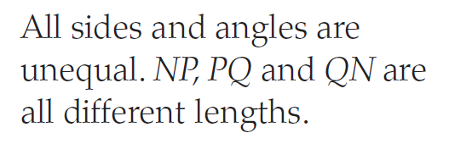
24
7
30
Naming Triangles
Date
EQ – How can we use angles and sides to name triangles?
Question
Examples
Steps
Naming Triangles due to their Angles
Naming Triangles due to their Sides

Slide 9
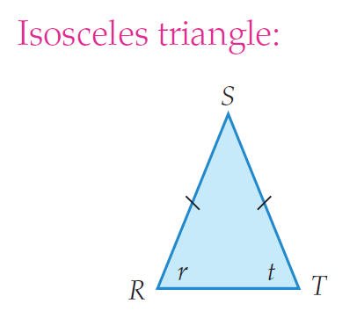
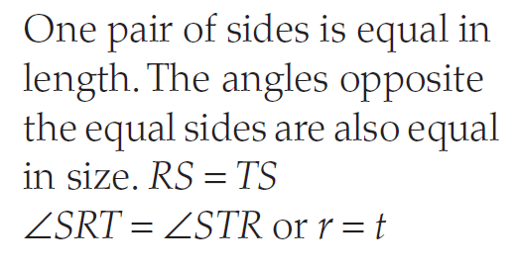
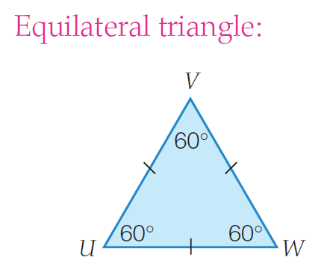
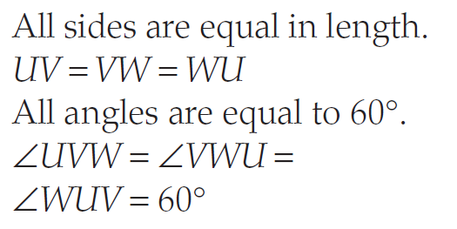
24
7
30
Naming Triangles
Date
EQ – How can we use angles and sides to name triangles?
Question
Examples
Steps
Naming Triangles due to their Sides

Slide 10

Write Your Summary
You have 3 minutes to write a summary that answers the Essential Question.
Be prepared to share your summary with the people sitting in your row.
This Photo by Unknown Author is licensed under CC BY-NC-ND

Slide 11
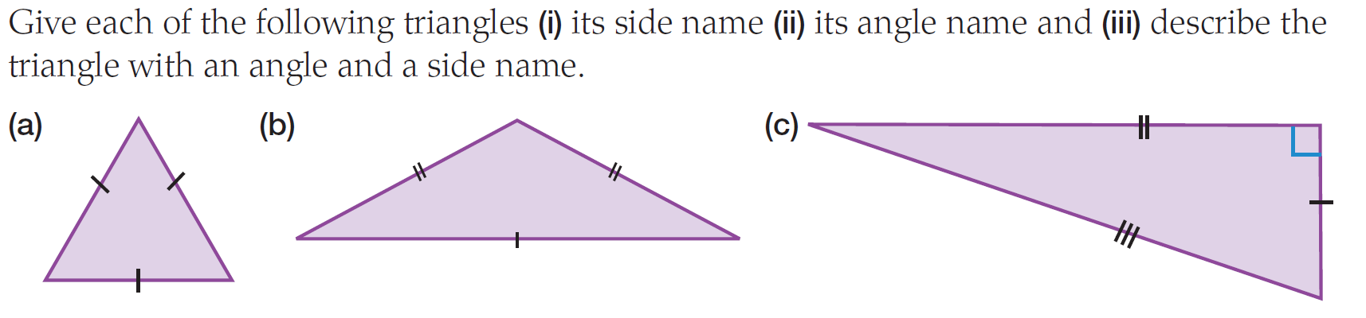
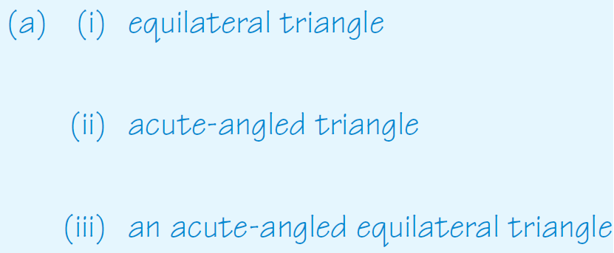
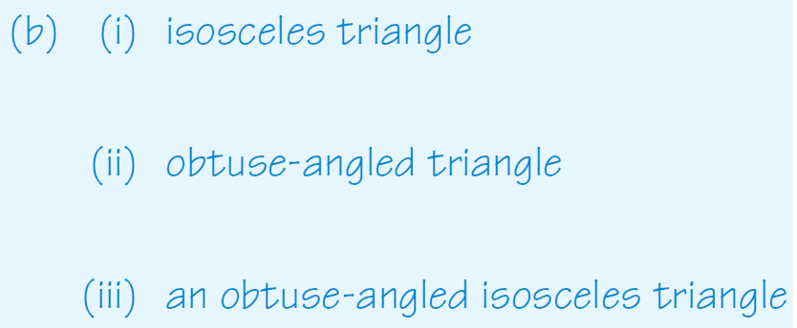
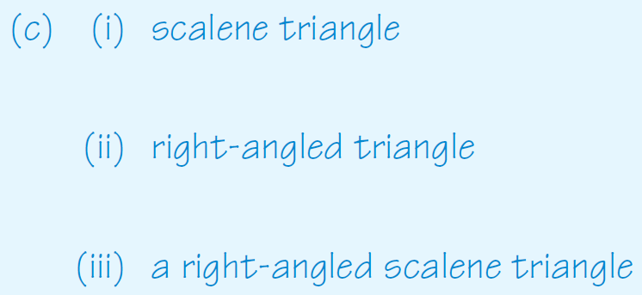
We do

Slide 12
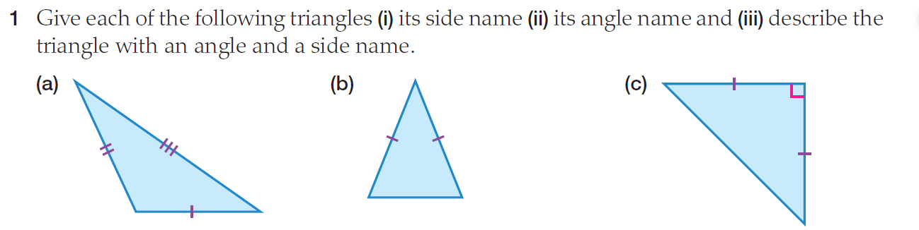
You do

Slide 13
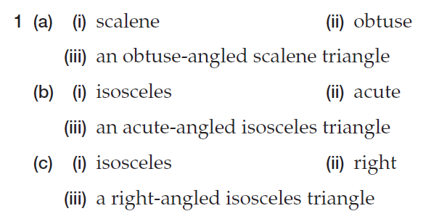
answers

Slide 14
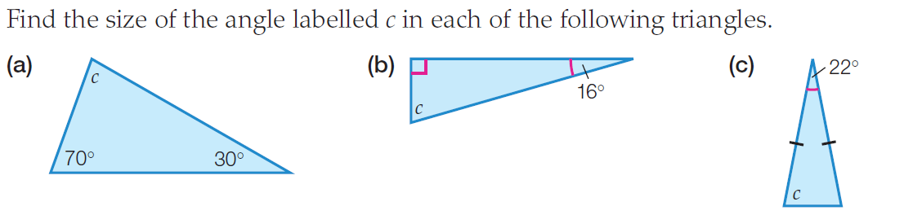
We do

Slide 15
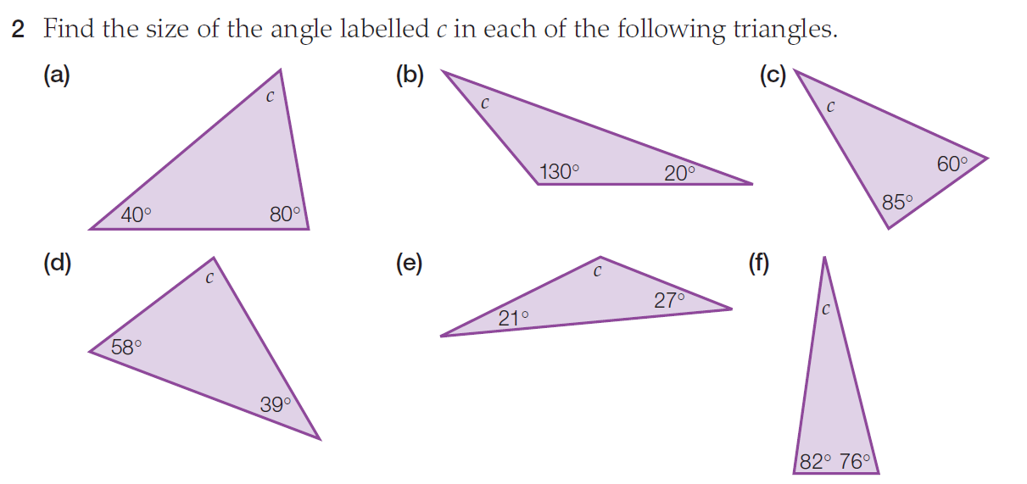
You do

